Slide 1
A4: Visualization in python
Tutorial

Slide 2
Overview
To learn concepts of visualization
To learn data analysis using visualization
To learn using visualization tools in Python

Slide 3

Visualization
In Data Science: highlighting the key aspects of data
what are the most important variables,
what is their relative importance,
what are the changes and trends
Should be visually appealing but not at the expense of loading it with unnecessary data.
Should not be misleading (sometimes is intentional).

Slide 4
MATPLOT
matplotlib is the most used Python package for 2D-graphics
Provides a very quick way to visualize data from Python Provides publication-quality figures in many formats.
We are going to explore matplotlib covering most common cases.

Slide 5
PANDAS
Pandas is an open-source, BSD-licensed Python library
High-performance, easy-to-use data structures and data analysis tools for the Python programming language.
Python with Pandas is used in a wide range of fields including:
academic and
commercial domains including finance, economics, Statistics, analytics, etc.

Slide 6
Assignment 4 tasks

Slide 7
Prerequisites
For python install
numpy,
pandas,
matplot,
basemap (matplot extension for geo plotting, works with python 3.2, 2.7)

Slide 8
Matplot

Slide 9
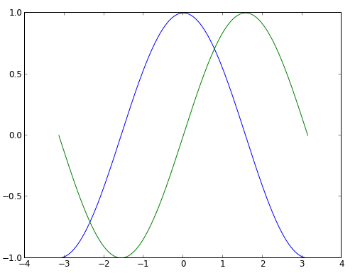
Simple line plot
import numpy as np
import matplotlib.pyplot as plt
X = np.linspace(-np.pi, np.pi,\ 256, endpoint=True)
C,S = np.cos(X), np.sin(X)
plt.plot(X,C)
plt.plot(X,S)
plt.show()

Slide 10
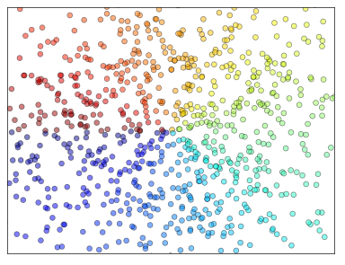
Scatter plot
# -----------------------------------------------------------------------
# Copyright (c) 2015, Nicolas P. Rougier. All Rights Reserved.
# Distributed under the (new) BSD License. See LICENSE.txt for more info.
# -----------------------------------------------------------------------
import numpy as np
import matplotlib.pyplot as plt
n = 1024
X = np.random.normal(0,1,n)
Y = np.random.normal(0,1,n)
T = np.arctan2(Y,X)
plt.axes([0.025,0.025,0.95,0.95])
plt.scatter(X,Y, s=75, c=T, alpha=.5)
plt.xlim(-1.5,1.5), plt.xticks([])
plt.ylim(-1.5,1.5), plt.yticks([])
# savefig('../figures/scatter_ex.png',dpi=48)
plt.show()

Slide 11
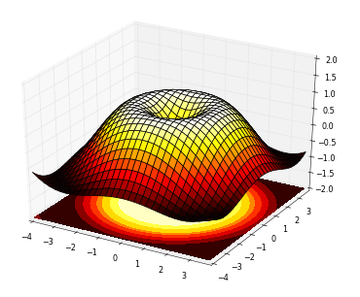
3D plots
# -----------------------------------------------------------------------------
# Copyright (c) 2015, Nicolas P. Rougier. All Rights Reserved.
# Distributed under the (new) BSD License. See LICENSE.txt for more info.
# -----------------------------------------------------------------------------
import numpy as np
import matplotlib.pyplot as plt
from mpl_toolkits.mplot3d import Axes3D
fig = plt.figure()
ax = Axes3D(fig)
X = np.arange(-4, 4, 0.25)
Y = np.arange(-4, 4, 0.25)
X, Y = np.meshgrid(X, Y)
R = np.sqrt(X**2 + Y**2)
Z = np.sin(R)
ax.plot_surface(X, Y, Z, rstride=1, cstride=1, cmap=plt.cm.hot)
ax.contourf(X, Y, Z, zdir='z', offset=-2, cmap=plt.cm.hot)
ax.set_zlim(-2,2)
# savefig('../figures/plot3d_ex.png',dpi=48)
plt.show()

Slide 12
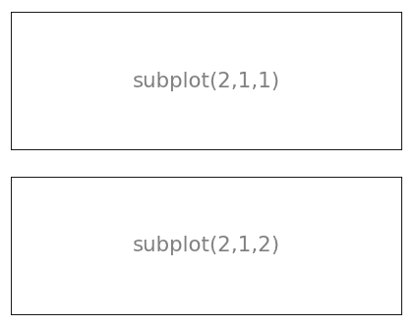
SUBPLOTS - 1
from pylab import *
subplot(2,1,1)
xticks([]), yticks([])
text(0.5,0.5, 'subplot(2,1,1)',ha='center',va='center',size=24,alpha=.5)
subplot(2,1,2)
xticks([]), yticks([])
text(0.5,0.5, 'subplot(2,1,2)',ha='center',va='center',size=24,alpha=.5)
# plt.savefig('../figures/subplot-horizontal.png', dpi=64)
show()

Slide 13
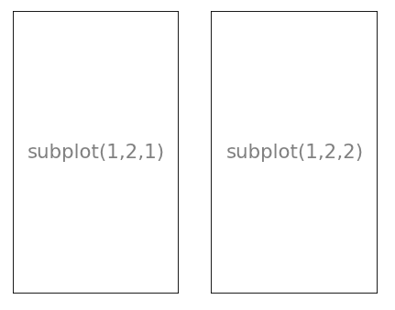
SUBPLOTS - 2
from pylab import *
subplot(1,2,1)
xticks([]), yticks([])
text(0.5,0.5, 'subplot(1,2,1)',ha='center',va='center',size=24,alpha=.5)
subplot(1,2,2)
xticks([]), yticks([])
text(0.5,0.5, 'subplot(1,2,2)',ha='center',va='center',size=24,alpha=.5)
# plt.savefig('../figures/subplot-vertical.png', dpi=64)
show()

Slide 14
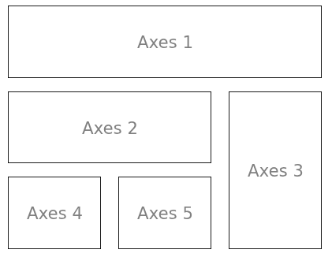
SUBPLOTS with axes
from pylab import *
import matplotlib.gridspec as gridspec
G = gridspec.GridSpec(3, 3)
axes_1 = subplot(G[0, :])
xticks([]), yticks([])
text(0.5,0.5, 'Axes 1',ha='center',va='center',size=24,alpha=.5)
axes_2 = subplot(G[1,:-1])
xticks([]), yticks([])
text(0.5,0.5, 'Axes 2',ha='center',va='center',size=24,alpha=.5)
axes_3 = subplot(G[1:, -1])
xticks([]), yticks([])
text(0.5,0.5, 'Axes 3',ha='center',va='center',size=24,alpha=.5)
axes_4 = subplot(G[-1,0])
xticks([]), yticks([])
text(0.5,0.5, 'Axes 4',ha='center',va='center',size=24,alpha=.5)
axes_5 = subplot(G[-1,-2])
xticks([]), yticks([])
text(0.5,0.5, 'Axes 5',ha='center',va='center',size=24,alpha=.5)
#plt.savefig('../figures/gridspec.png', dpi=64)
show()

Slide 15
Geo spatial plotting

Slide 16
Basemap or cartopy
The matplotlib basemap toolkit is a library for plotting 2D data on maps in Python.
https://matplotlib.org/basemap/users/intro.html
Cartopy is designed for geospatial data processing in order to produce maps and other geospatial data analyses.
Will in future replace Basemap.
https://scitools.org.uk/cartopy/docs/latest/index.html

Slide 17
INSTALLING Basemap ON WINDOWS
This is an easy way to install for py 3.6+. Assuming that you have python already installed, go to:
https://www.lfd.uci.edu/~gohlke/pythonlibs/
… and find wheel for your machine. Download it.
Then install it with pip3:
pip3 install <basemap_wheel_file>.whl
Fix to work with different map styles:
pip3 install image

Slide 18
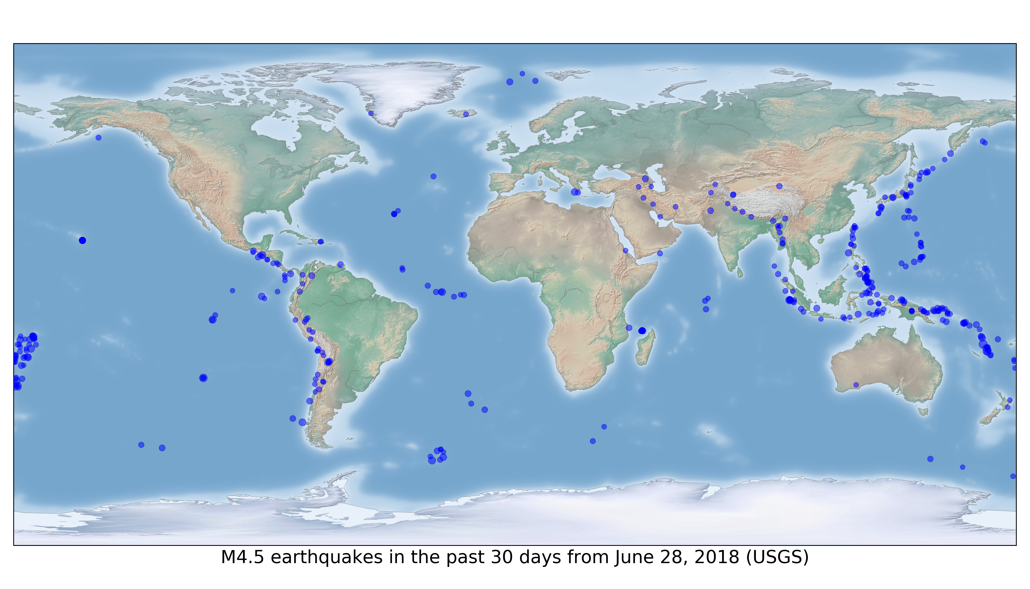
BASEMAP EXAMPLE
import matplotlib.pyplot as plt
from mpl_toolkits.basemap import Basemap
from pandas import read_csv
# Data downloaded from 'http://earthquake.usgs.gov/earthquakes/feed/v1.0/summary/4.5_month.csv'
# Setting up custom style
style.use(['seaborn-poster'])
quakeFrame = read_csv('4.5_month.csv')
lngs = quakeFrame['longitude'].astype('float')
lats = quakeFrame['latitude'].astype('float')
mags = quakeFrame['mag'].astype('float').apply(lambda x: 2 ** x)
plt.figure(figsize=(14, 8))
earth = Basemap()
earth.drawcoastlines(color='0.50', linewidth=0.25)
earth.shadedrelief()
plt.scatter(lngs, lats, mags,
c='blue',alpha=0.5, zorder=10)
plt.xlabel("M4.5 earthquakes in the past 30 days from June 28, 2018 (USGS)")
# Workaround for blanc image saving
fig1 = plt.gcf()
plt.show()
plt.draw()
fig1.savefig('4.5quakes.png', dpi=350)

Slide 19
References
Dataset to use:
https://catalogue-hrm.opendata.arcgis.com/datasets/building-permits
Tutorial on Pandas:
https://www.tutorialspoint.com/python_pandas/index.htm
Pandas official documentation:
https://pandas.pydata.org/pandas-docs/stable/tutorials.html
Tutorial on Matplot:
https://www.labri.fr/perso/nrougier/teaching/matplotlib/matplotlib.html#d-plots
Matplot official Documentation:
https://matplotlib.org/

